Slide 1
Experiences of Cloud Storage Service Monitoring
Performance Assessment and Comparison
Enrico Bocchi
Idilio Drago
Marco Mellia
Cloud Services for Synchronisation and Sharing (CS3)
ETH Zurich, Switzerland

Slide 2
Motivation and Goals
Personal cloud storage services are popular among users
Share content with colleagues and friends seamlessly
Synchronize multiple devices
Market is crowded by offers
Providing a significant amount of free storage
Relying on ad-hoc protocols and proprietary designs
Which architectural designs are adopted?
Where are datacenters located?
How is synchronization tackled?
Do clients implement advanced capabilities?
How long does it take to synchronize devices?

Slide 3
Methodology
Methodology based on active experiments
Unveil service architecture and client capabilities
Understand implications of design choices on performance
Instrumentation of a benchmarking environment
Testbed to run customizable and repeatable tests
Black-box testing approach
Focus on network traffic produced by storage services
Target audience
Potential customers comparing alternatives and taking informed decisions
Engineers, developers, researchers facing service design and implementation challenges

Slide 4
Storage Services Under Test
Case study of 11 storage services
Point of view of European customers
Vantage point for measurements in Torino, Italy
Data collected in 2nd semester 2014
Service | Version |  | Service | Version
Box | 4.0.5101 |  | Mega | 1.0.5
Cloud Drive (Amazon) | 2.4.2013 |  | OneDrive (Microsoft) | 17.3.1166
Copy | 1.45 |  | Wuala | Olympus
Dropbox | 2.8.4
Google Drive | 1.16.7 |  | Horizon | 1.5.0
hubiC | 1.2.4.79 |  | ownCloud | 1.5.2

Slide 5
2
System Architecture Discovery

Slide 6
Testbed: Learning phase
How to identify traffic flows to storage providers?
Traffic can be classified as
Control authentication, files meta-data, notification of changes
Storage payload of users’ files
All traffic to storage providers is encrypted
Curiosity: Wuala uses plain HTTP as encryption is performed by the application
Applications under test
Monitoring Gateway
Storage Providers
Passive monitoring
Compile hostnames lists
e.g., upload.drive.google.com

Slide 7
Data Center Topology
First question: Where are datacenters located?
From learning phase, collect a list of hostnames for each service
Resolve each hostname using ~2,000 open DNS servers
Locate IP addresses
Triangulation from PlanetLab nodes and Airport-Tags in FQDNs
Service | Topology | Datacenters | RTT [ms]
Dropbox | Centralized | U.S. | 100
Google Drive | Distributed | Worldwide | 10
OneDrive | Partially Distributed | U.S./Asia | 130
Cloud Drive | Partially Distributed | U.S./Europe | 45
Mega | Partially Distributed | Europe/Oceania | 45
Wuala, hubiC | Centralized | Europe | 35, 25
Box, Copy | Centralized | U.S. | 170, 120

Slide 8
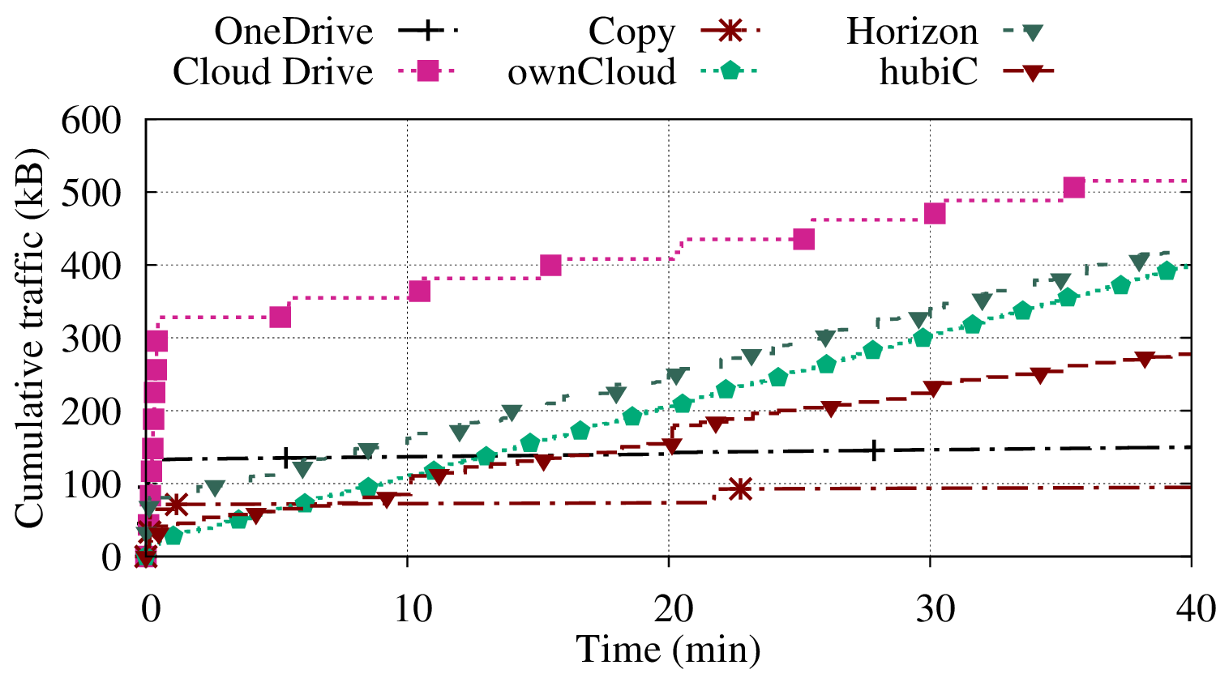
Background Traffic
Second question: What happens when apps run in idle state?
Two phases: login and polling for changes
Common polling interval is 60s
Wuala and Cloud Drive use 5min
Cloud Drive is more chatty during login
Horizon 1.04kb/s
ownCloud 1.24kb/s
hubiC 0.72kb/s, increases as more files are added 12kb/s with 90MB in 450 files

Slide 9
3
Client Capabilities

Slide 10
Testbed: Active Measurements
How is synchronization tackled?
Do clients implement advanced capabilities?
1. Workload
TestPC Upload
Testing Application
FTP server
Post-process and
identify capabilities
Server names
IP address
Number of connections
Number of transferred bytes
…
Traffic capture
Applications
under test
2. Upload
Storage Providers

Slide 11
Capabilities
How is synchronization tackled?
Do clients implement advanced capabilities?
 | Bundling | Chunking (size [MB]) | Compression | Dedupl. | Delta Encoding | P2P Sync.
Dropbox | ✓ | 4 | Always | ✓ | ✓ | ✓
Google Drive | ✗ | 8Down | Smart | ✗ | ✗ | ✗
Copy | ✗ | 5 | ✗ | ✓ | ✗ | ✓
Wuala | ✗ | 4 | ✗ | ✓ | ✗ | ✗
ownCloud | ✗ | ✗ | Smart | ✗ | ✗ | ✗
Horizon, Mega | ✗ | 1Up | ✗ | Partial | ✗ | ✗
OneDrive | ✗ | 4Up - 1Down | ✗ | ✗ | ✗ | ✗
Cloud Drive, Box, hubiC | ✗ | ✗ | ✗ | ✗ | ✗ | ✗

Slide 12
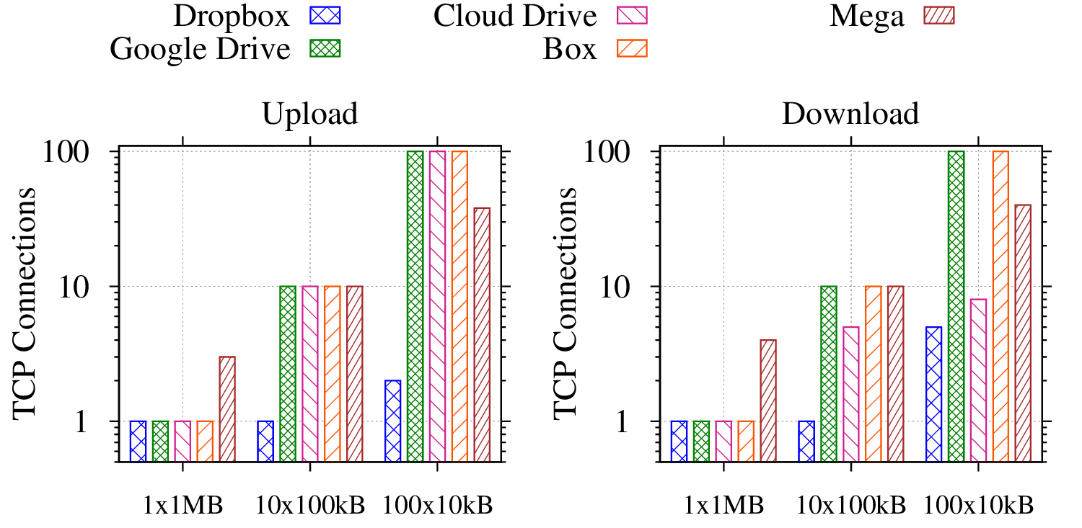
Bundling
How to upload or download a batch of files?
Do services open one connection per file?

Slide 13
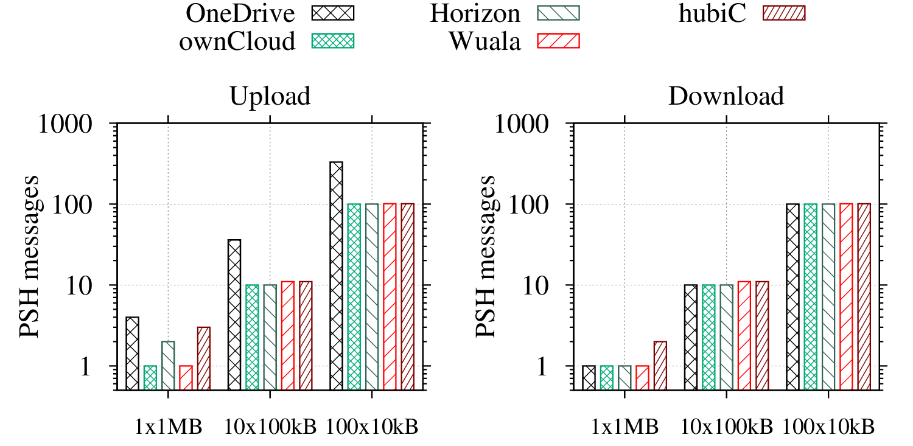
Bundling
How to disambiguate if one connection carries more files?
Use TCP-PSH messages as transaction delimiters
How to upload or download a batch of files?
Do services open one connection per file?
OneDrive opens multiple concurrent connections
Other services transfer files sequentially

Slide 14
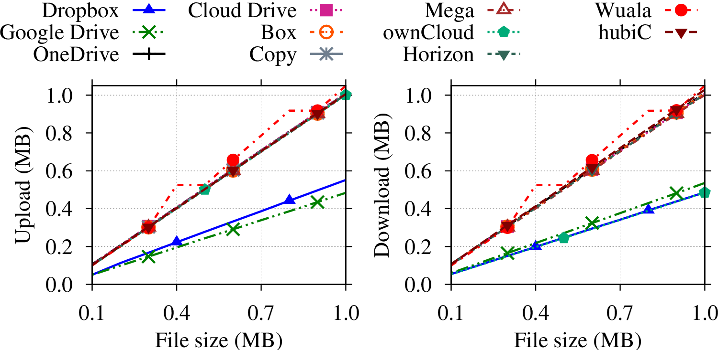
Compression
Are files compressed before being transferred?
Test with highly compressible text files
Dropbox and Google Drive implement compression
ownCloud compresses files for download only

Slide 15
Compression
Are files compressed before being transferred?
Test with highly compressible text files
TAKEAWAY
Advanced capabilities depend on client implementation
Service providers show diverse approaches i.e., sophisticated VS lightweight clients
Their usefulness is strongly related to workload
Each capability might be less effective or counter-productive
ownCloud compresses files for download only

Slide 16
4
End-user Performance

Slide 17
Testbed: Active Measurements
How is synchronization tackled?
How long does it take to synchronize devices?

Slide 18
Testbed: Active Measurements
How is synchronization tackled?
How long does it take to synchronize devices?
1. Workload
TestPC Upload
Testing Application
FTP server
FTP Transfer
Traffic capture
T_{Start-up}
Applications
under test
Upload start
2. Upload
Upload end
T_{Upload}
Cloud Providers
3. Download
Download start
TestPC Download
T_{Propag}
Applications
under test
T_{Download}
FTP server
Download end

Slide 19
Testbed: Active Measurements
1. Workload
TestPC Upload
Testing Application
FTP server
FTP Transfer
Traffic capture
T_{Start-up}
Applications
under test
Upload start
2. Upload
Upload end
T_{Upload}
Cloud Providers
3. Download
Download start
TestPC Download
T_{Propag}
Applications
under test
T_{Download}
FTP server
Download end

Slide 20
Testbed: Active Measurements
Workloads
Workload Generation
Upload Starts
Download Starts
Upload Ends
Download Ends
T_{Start-up}
Time
Start up
Upload (TestPC Upload)
Propagation
T_{Upload}
Download (TestPC Download)
Files | Binary | Text | Total Size | Replicas | Note
1 | 1 | - | 100 kB | -
1 | 1 | - | 1 MB | -
1 | 1 | - | 20 MB | -
100 | 50 | 50 | 1 MB | -
365 | 194 | 171 | 87 MB | 97 (5.4 MB) | Crowd-sourced realistic dataset
312 | 172 | 140 | 77 MB | 136 (5.5 MB)
T_{Propag}
T_{Download}

Slide 21
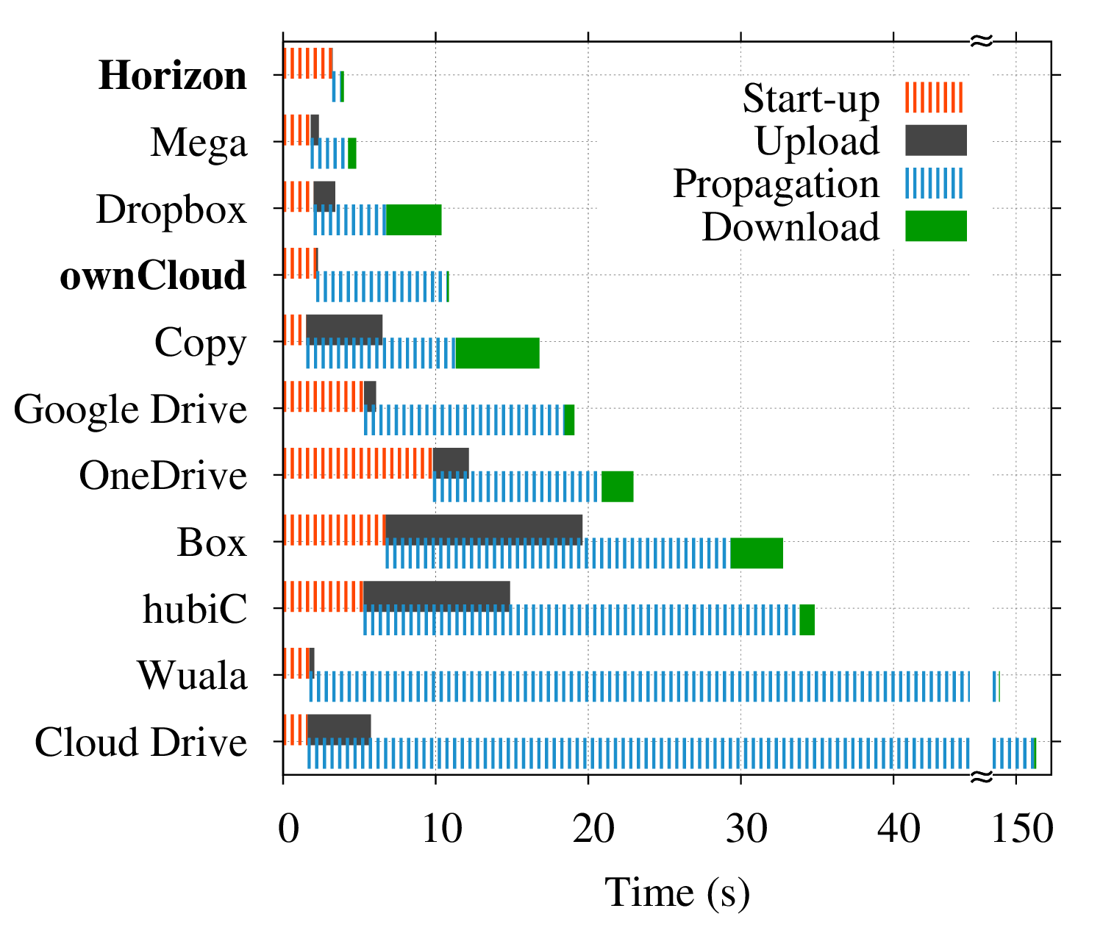
Synchronization Delay
Workload:
Single file, 1MB
ownCloud takes more than 10s to synchronize 1MB
Wuala and Cloud Drive are severely limited by implementation choices

Slide 22
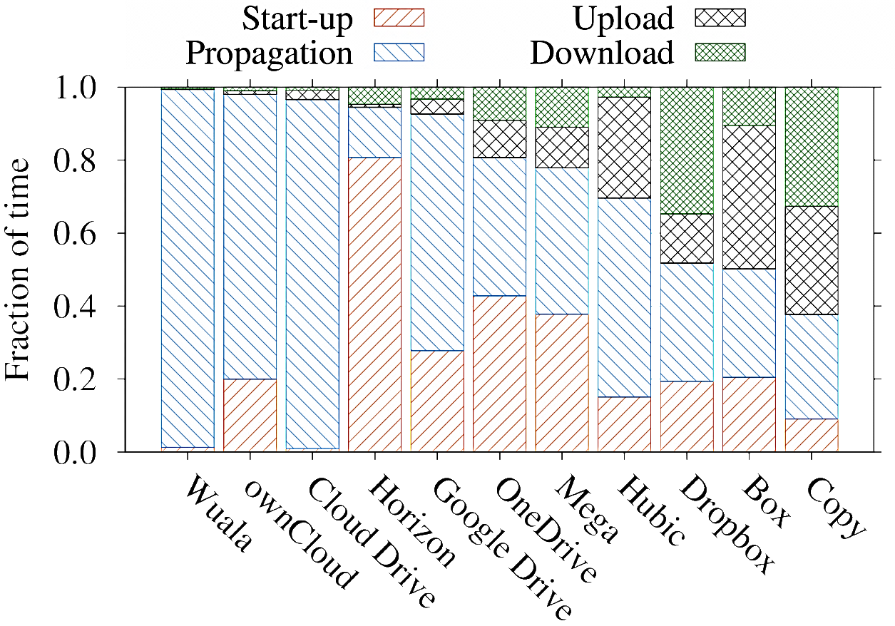
Synchronization Delay
Workload:
Single file, 1MB
ownCloud takes more than 10s to synchronize 1MB
In 7 cases out of 11, network time accounts for less then 25%

Slide 23
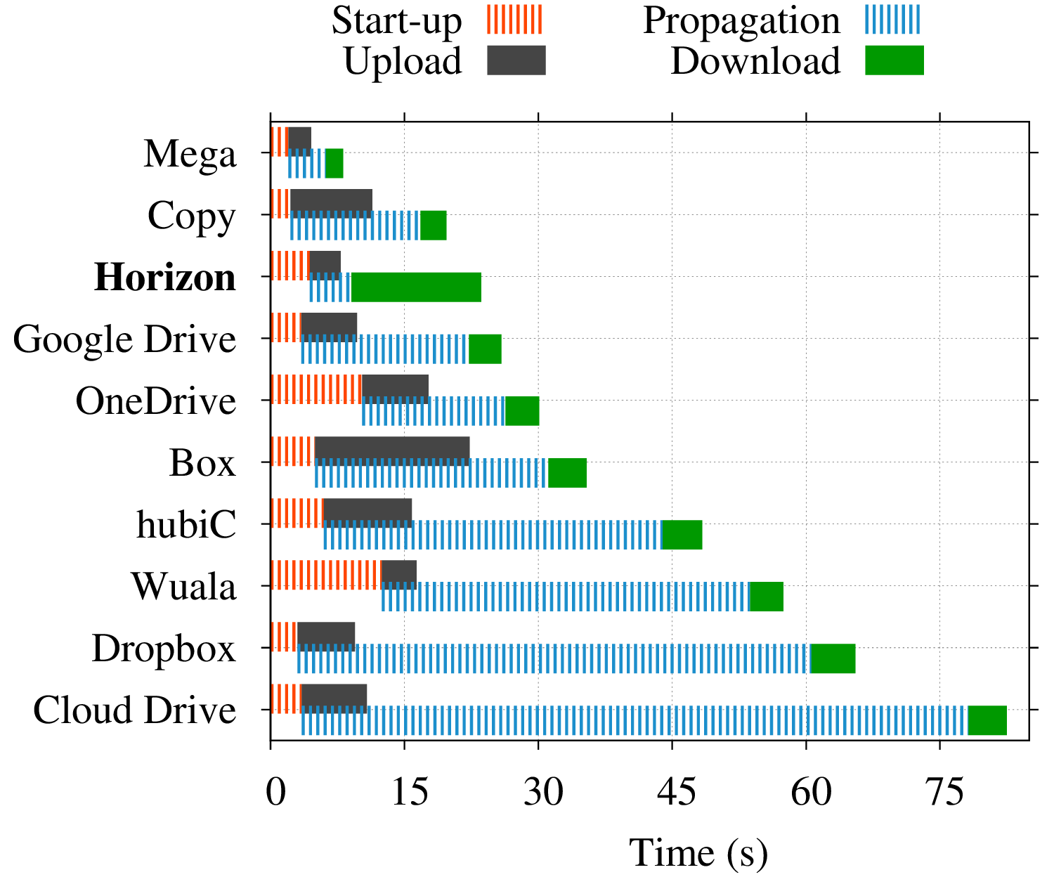
Synchronization Delay
Workload:
Single file, 1MB
With 3G connectivity?
Network transfer time is higher for all services
Synchronization in 24s (<4s with campus network)
Service | 3G time |  | Service | 3G time
Box | +7.3% |  | Horizon | +348.8%
Cloud Drive | -73.7% |  | hubiC | +35.9%
Copy | +8.7% |  | Mega | +105.8%
Dropbox | +189.4% |  | OneDrive | +36.0%
Google Drive | +30.7% |  | Wuala | -24.2%

Slide 24
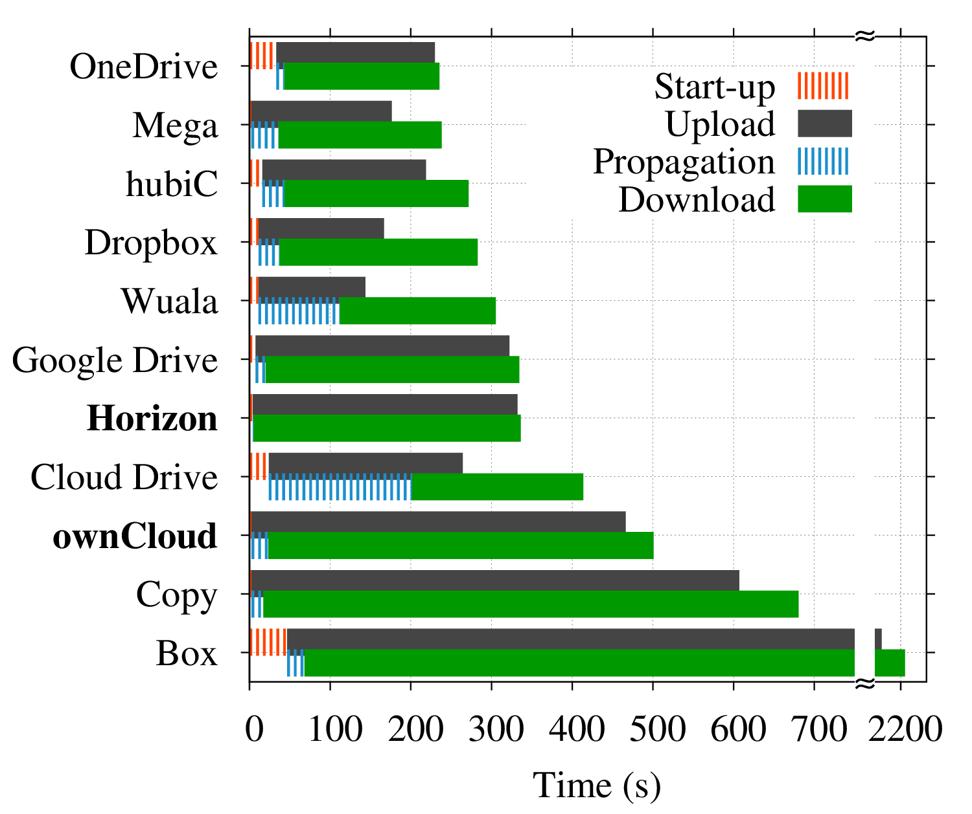
Synchronization Delay
Workload:
Realistic – 365 Files
194 binary, 171 text
87MB total size
97 files replicas (5.4MB)

Slide 25
Synchronization Delay
Workload:
Realistic – 365 Files
194 binary, 171 text
87MB total size
97 files replicas (5.4MB)
Mega is the most reactive, with very low start-up time
TAKEAWAY
Latency and throughput are key parameters for performance
3G performance tests show worse results
Reactive services can outperform more sophisticated solutions
Poor protocol design strongly penalizes overall performance
Horizon and ownCloud perform poorly with complex workloads
Box requires x10 time compared to best services

Slide 26
5
Conclusions

Slide 27
Summary of Benchmark Results
Service | Capabilities | Latency [ms] | Synchronization Time [s]
 |  |  | 1MB | 87MB--365 files
OneDrive | + | 130 | 23 | 235
Mega | ++ | 45 | 5 | 238
hubiC | - | 25 | 35 | 271
Dropbox | ++++++ | 100 | 10 | 283
Wuala | ++ | 35 | 136 | 305
Google Drive | ++ | 10 | 19 | 334
Cloud Drive | - | 45 | 167 | 414
Copy | +++ | 120 | 17 | 680
Box | - | 170 | 33 | 2,208
Horizon | ++ | <1 | 4 | 336
ownCloud | + | <1 | 11 | 501
Services with higher latency perform equally well
Local services win benchmarks with small workloads

Slide 28
Summary of Benchmark Results
Service | Capabilities | Latency [ms] | Synchronization Time [s]
 |  |  | 1MB | 87MB--365 files
OneDrive | + | 130 | 23 | 235
Mega | ++ | 45 | 5 | 238
hubiC | - | 25 | 35 | 271
Dropbox | ++++++ | 100 | 10 | 283
Wuala | ++ | 35 | 136 | 305
Google Drive | ++ | 10 | 19 | 334
Cloud Drive | - | 45 | 167 | 414
Copy | +++ | 120 | 17 | 680
Box | - | 170 | 33 | 2,208
Horizon | ++ | <1 | 4 | 336
ownCloud | + | <1 | 11 | 501
Concurrent transfers boost performance despite the simple client
Services with higher latency perform equally well
Advanced capabilities are a plus with complex workloads
Local services win benchmarks with small workloads

Slide 29
Conclusions
Capability effectiveness is dependent on the workload used
Latency and throughput are of key importance, but…
Protocols and client design severely affect synchronization time
Which is the best cloud storage service for your needs?
Prospected usage
Collaborative work (e.g., editing of textual files)
Storage/Sharing of large files (e.g., photos, videos)
Geographic constraints
Latency to the datacenter

Slide 30
Experiences of Cloud Storage Service Monitoring
Performance Assessment and Comparison
Data and scripts can be downloaded from http://www.simpleweb.org/wiki/Cloud_benchmarks
enrico.bocchi@polito.it
enrico.bocchi

